Slide 1
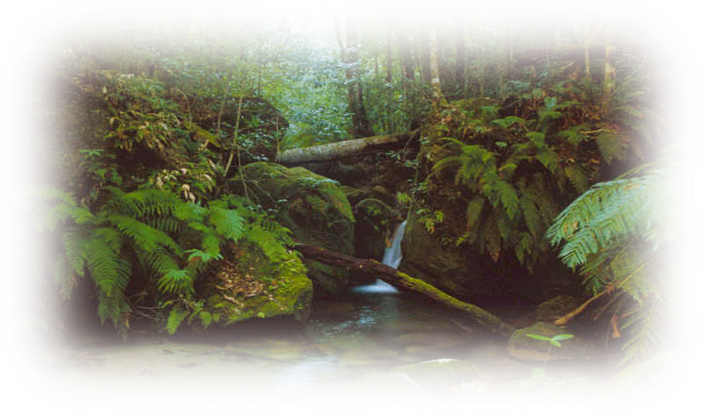
Rainforests
SANGAMESHWAR COLLEGE, SOLAPUR
(AUTONOMOUS)
Presented by :
Mateen Satkhed
2342120
BCA-II

Slide 2
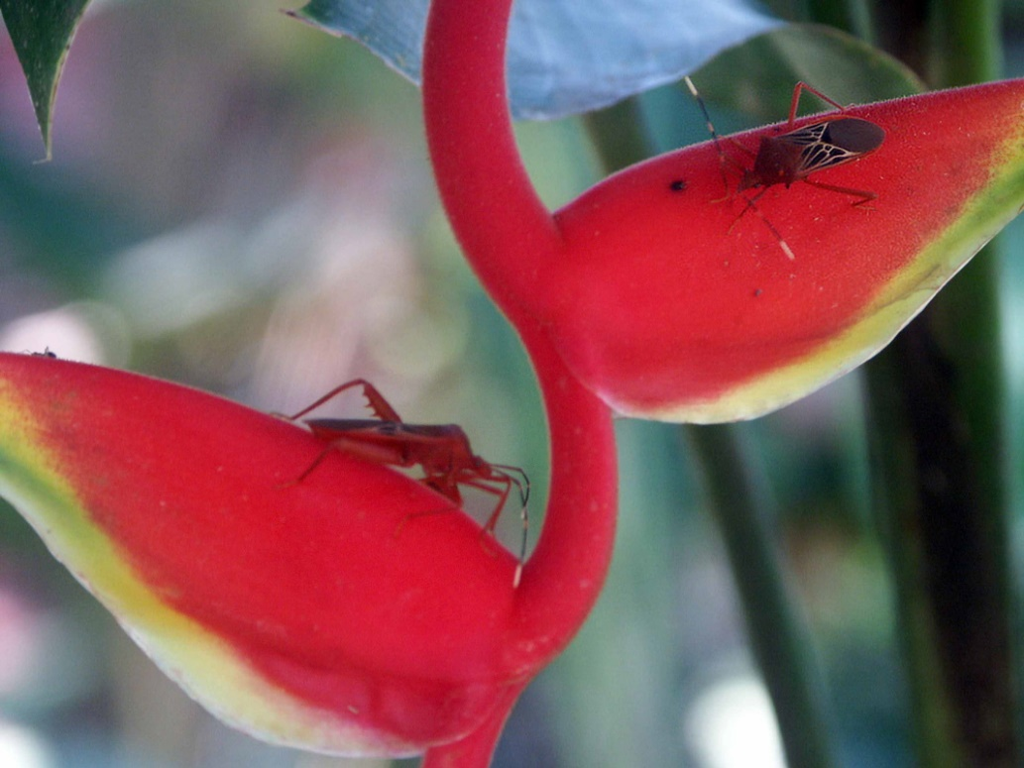
What is a Rainforest?
Rainforests are very dense, warm, wet forests, havens for millions of plants and animals that exist nowhere else on earth.
Notes:
http://www.enchantedlearning.com/subjects/rainforest/
http://www.spa3.k12.sc.us/WebQuests/Rainforests/

Slide 3
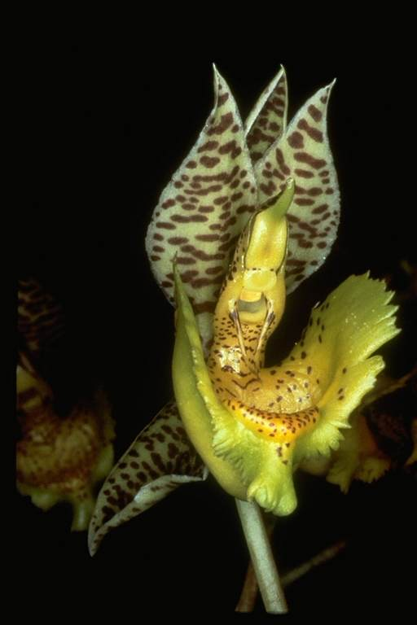
Why are rainforests important?
The plants of the rainforest generate much of the Earth's oxygen.
These plants are also very important to people in other ways; many are used in new drugs that fight disease and illness.

Slide 4

Rainforests and the Ecosystem
Tropical rainforests cover about 7% of the Earth's surface and are VERY important to the Earth's ecosystem. The rainforests recycle and clean water.
They also remove carbon dioxide from the atmosphere and store it in their roots, stems, leaves, and branches, deterring the greenhouse effect.
Notes:
The greenhouse effect is an increase in the temperature of a planet as heat energy from sunlight is trapped by the gaseous atmosphere. Excess carbon dioxide and water vapor increase this global warming effect.

Slide 5
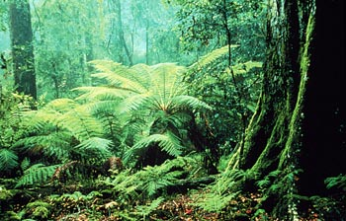
Types of Rainforest
Temperate rainforests are much younger than their tropical relatives, less than 10,000 years old, compared to tropical rainforests that may be millions of years old!

Slide 6
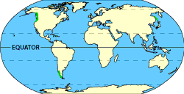
Temperate Rainforests
Temperate rainforests are much more scarce than tropical rainforests. They are found on the western edge of North and South America, where moist air from the Pacific Ocean drops up to 200 inches of rain a year.

Slide 7
Rainforests are often called the lungs of the planet for their role in absorbing carbon dioxide, a greenhouse gas, and producing oxygen, upon which all animals depend for survival. Rainforests also stabilize climate, house incredible amounts of plants and wildlife, and produce nourishing rainfall all around the planet.

Slide 8
Thank
You……

